Slide 1

Crowdsourced POI Labelling: Location-Aware Result Inference and Task Assignment
Huiqi Hu, Yudian Zheng, Zhifeng Bao, Guoliang Li, Jianhua Feng, Reynold Cheng
Tsinghua University, RMIT, The University of Hong Kong
May 20162016

Slide 2
Outline
Motivation
Problem Statement
Inference Model
Task Assignment
Experiment
Conclusion

Slide 3

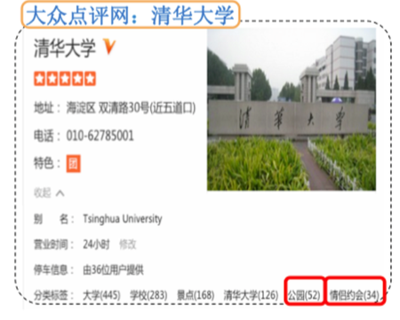
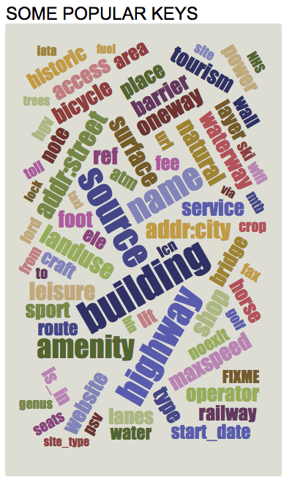
Motivation(1)
POI Labels
Improve user experience
Help resource retrieval
Benefit applications
e.g. activity recommendation
Meetup
www.dianping.com
OpenStreetMap
Notes:
POI labels have particular usages in location-based service. It can improve user experiment, we can get to know the information of points of interests by looking over the labels instead of scanning the textual description. Studies also show correct POI labels can also
Help resource retrieval, and benefit many applications, such as activity recommendation

Slide 4
Motivation(2)
POI Labels
Incorrect labels exist
Anonymous manual labelling maybe incredible or malicious
Limited accuracies of AI algorithms
www.dianping.com :Tsinghua University
The website tends to use frequent tags as labels
University
Campus
Scenery Spot
Park
Dating Couples
Notes:
However, in real application or websites, there exist a lot of incorrect labels,
It is the biggest website in China to offer Chineses POI information。 Incorrect labels exist
because anoymous worker may give incredible labels, also there are may exist malicious workers who give wrong labels. On the other hand, when we use existing artificial algorithm to generate labels, the acuucracy is limited. In this example

Slide 5
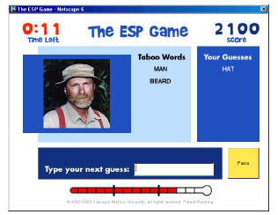
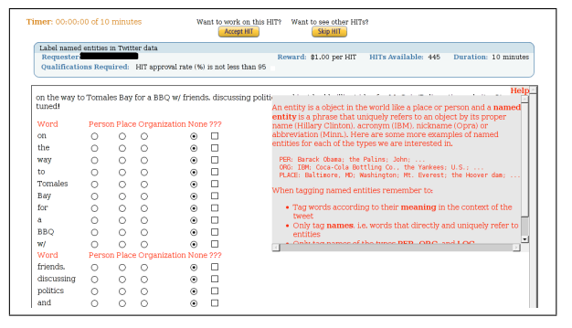
Motivation(3)
Crowdsourced POI Labelling
Ask crowdsourced workers to select correct labels from the candidate labels to improve the quality
Effectively handle computer-hard tasks
Achieved good performance in similar tasks
e.g. image labels, entity annotation
[Ahn et al. Labeling Images with a Computer Game]
[Finin et al. Annotating Named Entities in Twitter Data with Crowdsourcing
Notes:
In this paper, we study Crowdsourced POI Labelling
. Ask crowdsourced workers to select correct labels from the candidate labels to improve the quality
. As we know, crowdsourcing method is a popular apporach to hand computer-had tasks,

Slide 6
Outline
Motivation
Problem Statement
Inference Model
Task Assignment
Experiment
Conclusion

Slide 7
Problem Statement(1)
Crowdsourced POI Labelling
Identifying the correct labels of points of interest (POIs) based on answers from crowdsourced workers
www.dianping.com :Tsinghua University
University
Campus
Scenery Spot
Park
Dating Couples
Notes:
Our goal is to identify the correct labels of points of interest (POIs) based on answers from crowdsourced workers

Slide 8
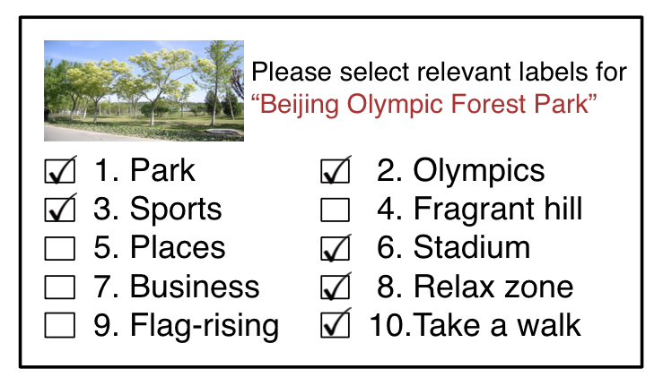
Problem Statement(2)
Task and Worker
Tasks:
A task：
Labels：
Workers submit
location with geo-coordinate， e.g. home, office
Answers
A task looks like:
Notes:
In POI labelling, workers should submit their location, for example their home or office, and they should submit their answers, if a worker think the label is a correct label for the POI, then he should tick it, it means it return rwtk is one , otherwise rwtk is zeor.
Since different worker have different selection or even conflick selections, so we need the true correct labels for each task.

Slide 9
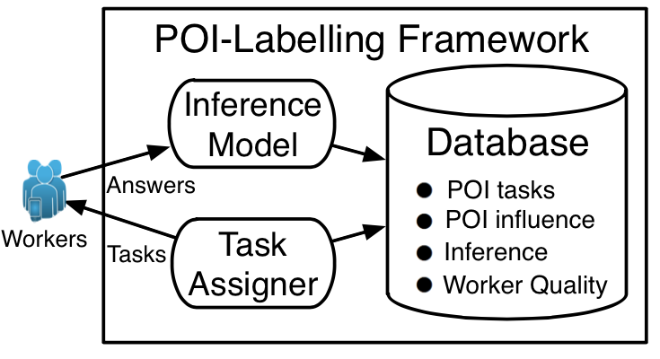

Problem Statement(3)
Framework
Dynamic workers: W
Assign h tasks for a worker at once：
Analyze through inference model
Assign tasks for next round workers
…
When budget runs out, infer the correct labels
Object: maximizing the overall accuracy
Q1：how to infer worker quality and correct label, etc. based on worker answers?
Q2：how to assign proper tasks to workers to improve accuracy? ->
how to assign tasks to works in each round to maximize the accuracy improvement?
Notes:
Next, we introduce the framework of POI-labelling. The framework works for dynamics workers, since all workers can not come at once, at a specific time, only a set of worker W are requiring tasks, and we should assign h tasks for each of them. Then the worker submit their answers, and a inference model will be used to analyze the answer, it will generate and keep some temporal information. The tempora will guide the task assigner to assign tasks for next round of workers. The framework ends until the budget runs out, for example , we may have a maximum of task assignments. Finally, we use the inferece model to infer the correct labels. Our object is to maximize the overall accuracy, which is defined as the percentages of correctly infered labels. There are two main questions in this framework

Slide 10
Problem Statement(4)
Overview
Inference Model
Input: worker answers
Output：inferred correct labels, worker quality, etc.
Task Assignment Algorithm
maximize the accuracy improvement for workers
Input: current inference results: worker quality, etc.
Output: assign h tasks for each worker
Notes:
Here we give an overview of our work

Slide 11
Outline
Motivation
Problem Statement
Inference Model
Task Assignment
Experiment
Conclusion

Slide 12
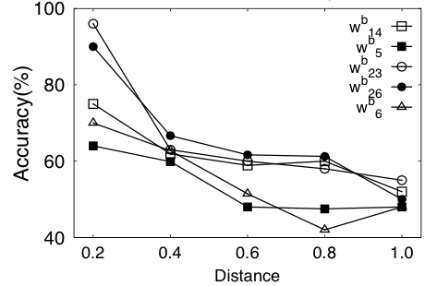
Inference Model(1)
Model Intuition
consider the issues that will affect answer accuracy
Issue 1-> Worker Quality
Inherent Quality :different background of worker
Distance-Aware Quality ：impact of distance towards worker quality
(i) Quality decrease with the increase of distance
(ii) The impact of distance varies for different workers
tasks：POIs of Beijing; Labels：tags from dianping.com
Notes:
The first issue is worker quality, which is consisted of two parts.
Another kind of worker quality is distance-aware qualtiy, it reflects the impact of distance towards worker quality
. Obviously for most of workers are more familiar POIs which near their location. As our collected information from tasks, the takks are POIs of beijing, the labels are tags from dianping.com, we get our conclusion, the quality does decrease with the increase of distance, the impact of distance varies for different workers, which means the decreasing rate of workers are different

Slide 13

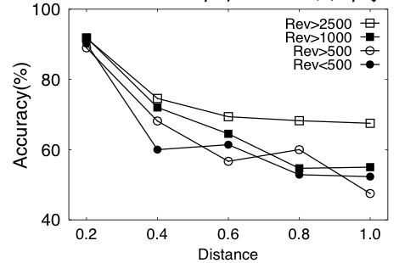
Inference Model(2)
Issue 2 -> POI-Influence ：
e.g. “The Beijing Olympic Park” is much more famous than “Beijing Botanical Garden”
(i) POIs with larger influence usually generate higher quality answers than less famous POIs.
(ii) POI-influences varies for different POIs
(iii) POI-influence decrease with the increase of distance
tasks：POIs of Beijing; Rev: #reviews from dianping.com
Notes:
If a POI is more famous, than workers tends to have better knowledge about it , for example. We use number of reviews to reflect their influence. In general ,we can find （1）

Slide 14
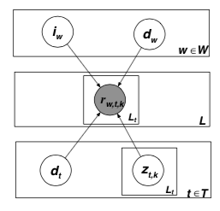
Inference Model(3)
A Graphical Probability Model
Random Variables
True result:
Inherit quality:
Distance-aware quality:
POI-influence:
Worker answer is generated based on a distribution conditioned over
Notes:
Based on the intuitions, we propose a graphical .probability model, the above issue we consider is modeled as random variables,it has 5 random variables.
Next we introduce them in detail

Slide 15
Inference Model(4)
A Graphical Probability Model
True result:
： is a correct label
Bernoulli distribution
: probability of
being a correct label
Inherent Quality
: w is an unqualified worker
e.g. spammer or worker without any knowledge
Bernoulli distribution
：probability of w being an unqualified worker
Notes:
First, ztk is the random varible to reprent true result . The higher the value it is ,the larger probability it being a correct label

Slide 16
Inference Model(5)
A Graphical Probability Model
Distance-aware Quality
follows a multinomial distribution over distance function set
POI-influence
follows a multinomial distribution over distance function set
Notes:
Distance-aware Quality is represented as dw and POI-influence is represented as dt.
They all follow a multimomial distribution over distance function set. We will introduce the function set next.

Slide 17



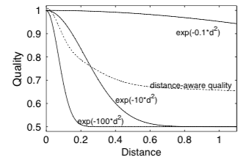

Inference Model(6)
Distance function set
Bell-shaped distance function
[0.5,1]
Decreasing rate depends on
Consists of a set of distance functions with fixed
Distance-aware Quality
POI-influence
d(w,t) is the normalized distance between worker and task
Linear combination of distance functions
Notes:
First we use a bell-shaped function the distance function, here d(w,t) is the normalized distance
Between worker and taskwe use the function because of two reasons, 1, the value range of the function is between [0.5,1], this is
Consistant towards answer accuracy, where 1 is the maximum accuracy. When user give random answers, the minimum accuracy is 50%. Second, the accuracy decrease with the increase of distance, and the decreasing rate depends on lamda. We can see the example, when lamda is …
The distance function set is consisted of …
Now we introduce disntance-aware qulaity, dw is a multimomial distribution, where P(flamdai) is the weigts of function f lamdai over the seat, so the distance-aware quality is the linear combination of distance functions . In the example

Slide 18

Inference Model(7)
基于众包的执行框架：
Model Answer Accuracy
工人答案准确率
Accuracy:
Probability of the worker answer is same to the true result
When w is an unqualified worker：
Worker gives random answers
When :
Depends on distance-aware quality and POI-influence
Notes:
Now we can model answer accuracy. The accuracy can be represented as P(), which is the probablity of the worker.
We consider two situations. [][]

Slide 19

Inference Model(8)
基于众包的执行框架：
Model Answer Accuracy
Answer Accuracy
The accuracy is depended on inherent quality, distance-aware quality and POI-influence
Notes:
By combing the two situation , we model the answer accuracy as follows. From the equation, we can also observe that , which is coincident to the graphical model

Slide 20
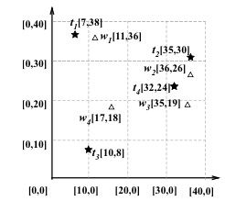
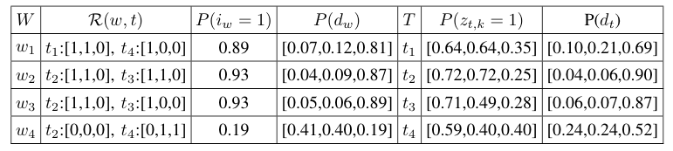

Inference Model(9)
An Example
基于众包的执行框架：
Tasks and workers
Worker Answers
Inherent Quality
Distance-aware Quality
tasks
Inference Result
POI-Influece
Learn the model
Maximize the likelihood of answers(MLE):
Expectation Maximum Algorithm (EM)
E-Step: computes
M-Step: computes
Notes:
Here is an example of our model.
The next question is how to learn the model

Slide 21
Outline
Motivation
Problem Statement
Inference Model
Task Assignment
Experiment
Conclusion

Slide 22
Task Assignment
Overview
Object
maximize the accuracy improvement for W
Assume workers are further assigned to task t
Q1: how to estimate accuracy improvement of t based on our inference model
Q2: how to assign h tasks for each worker to maximize the overall (for all tasks) accuracy improvement
论文发表

Slide 23

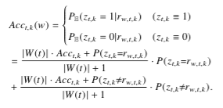
Accuracy Estimation(1)
Accuracy Definition
Accuracy of Label ：
The accuracy is depended on the true result
Situation 1: t is assigned to a single worker w
Based on inference model, estimated accuarcy
Expected probablity of the label being a correct one when the true result is yes
The modeled answer accuracy
论文发表
Current accuracy
Notes:
The accuracy is defined based on the true result of the label, if the true result is 1, than the higher the probability that ztk being one ,the hight accuracy it is . We need to consider two situations, first : t is assigned to … Based on the inference model and some mathematical transformation, we can compute the estimated accuracy as the following equation. It’s also depended on two situations, when the true result is yes, it is the Expectated probablity of the label being a correct one. The accuracy can computed base on current accuracy and the modeled answer accuracy we discussed before

Slide 24
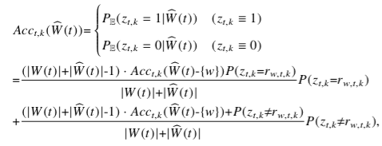
Accuracy Estimation(2)
Situation 2: t is assigned to a single multiple workers
Lemma 1：order of answers does not affect accuracy
Lemma 2: can be recursively computed via
It can be computed in linear time
Notes:
Next we consider ； this means the

Slide 25


Optimal Task Assignment Problem
Expected Accuracy Improvement
Cannot be aware of the true result in advance
When the true result is yes , the accuracy improvement
Probability of the true result is yes
Optimal Task Assignment Problem
Find an assignment to maximize the expected accuracy improvement
Lemma3：the problem is NP-hard
Greedy Algorithm
greedily picks a pair (task, worker) with maximum increase of accuracy until each worker in W has been assigned h tasks
Notes:
Since accuracy is defined based on the true result which we can not know in advance, we can only compute its expected value based current probablity, so we use the expected accuracy improvement. Then we can define the optimal task assigment problem. The problem is to find an assignment to …. The problem can be proved to be NP-hard, so we give an greedy algorithm as our task assignment algorithm, which

Slide 26
Outline
Motivation
Problem Statement
Inference Model
Task Assignment
Experiment
Conclusion
Notes:
答辩分为四部分的内容

Slide 27
Experiment
Datasets
Labels: tags from dianping.com
Beijing：200 POIs of Beijing；
China：200 Scenery spot of China
Deployment：
Crowdsourcing Platform: ChinaCrowds (chinacrowds.com)
Inference : every task receives 5 random worker answers
Task assignment：develop mode to support different assign algorithms, collect 1000 answers in total
Evaluating Methods：
Inference Method
Majority Vote(MV),Expectation-Maximum(EM), Inference Model(IM)
Task Assignment
Random assignment(Random), Spatial First(SF), Optimize Accuarcy-Greedy(AccOpt)
Notes:
We used two datasets, one dataset is Beijing, it contains 200 POIs of Beijing, another dataset is China, it contained 200 Scenery spot of china, the POIs are collected from dianping.com, the labels are its correct tags mixed with some incorrect tags manully.
We conducted experiment on ChinaCrowds, it has mobile applications, which support users to upload their locations. We adopt two depolyments, first, to evalute inference model, we let every takes 5 random worker answers.
Spatial First(SF) which assign the h closet undone task for each worker request.

Slide 28
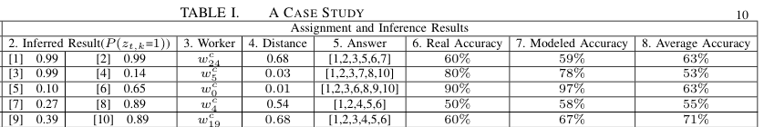
Evaluation of Inference Method
Case study
IM
EM
Notes:
The case study is trying to show the main difference of our infrence model and EM method. In em method， it can be considered as using average accuracy to model worker quality, how in our model, we consider distance-aware qualtiy, which is more correct in POI-labelling tasks.

Slide 29
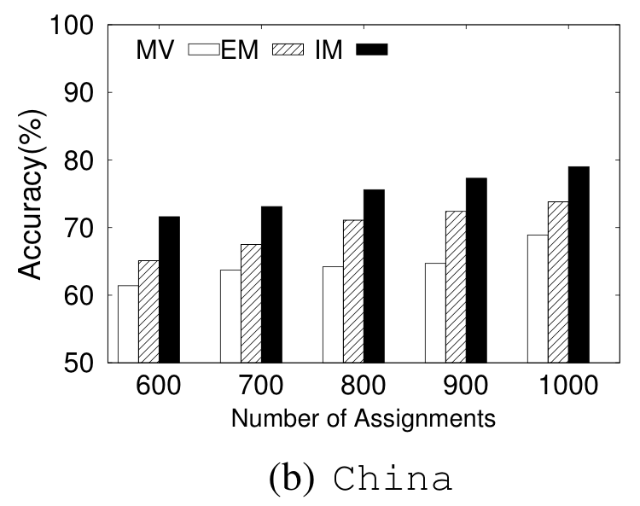
Evaluation of Inference Method
Accuracy

Slide 30
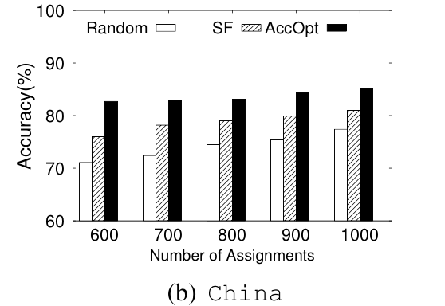
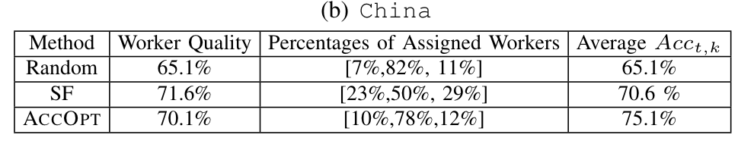
Evaluation of Task Assignment
Accuracy & some statistics
Notes:
SF will result in unbalanced assignments, where many percertanges of tasks have only got a few assigned workers.

Slide 31
Thanks！

